Slide 1
Employee Attrition
A predictive model
Nepanji Davis, Azmir Suljic, Hope Diebold
Notes:
Real world data set solving a real world problem. Helping them achieve their goal of putting together a strategic retention plan.

Slide 2

Why is attrition rate analytics important?
It enables the design of an employee retention model to keep valuable employees engaged and on board.
Cost
Attrition
Productivity
Training
Company culture
Employee Value
Performance Rating
Experience & Skills
Satisfaction Metrics
Notes:
1.5X for non leader/ 2.5 for tech/leadership

Slide 3

Reducing attrition translates into:
Consistent & higher productivity levels
Significant reduction in direct & indirect costs
Enhanced employee morale
Consistent customer service
Overall increased business performance.

Slide 4
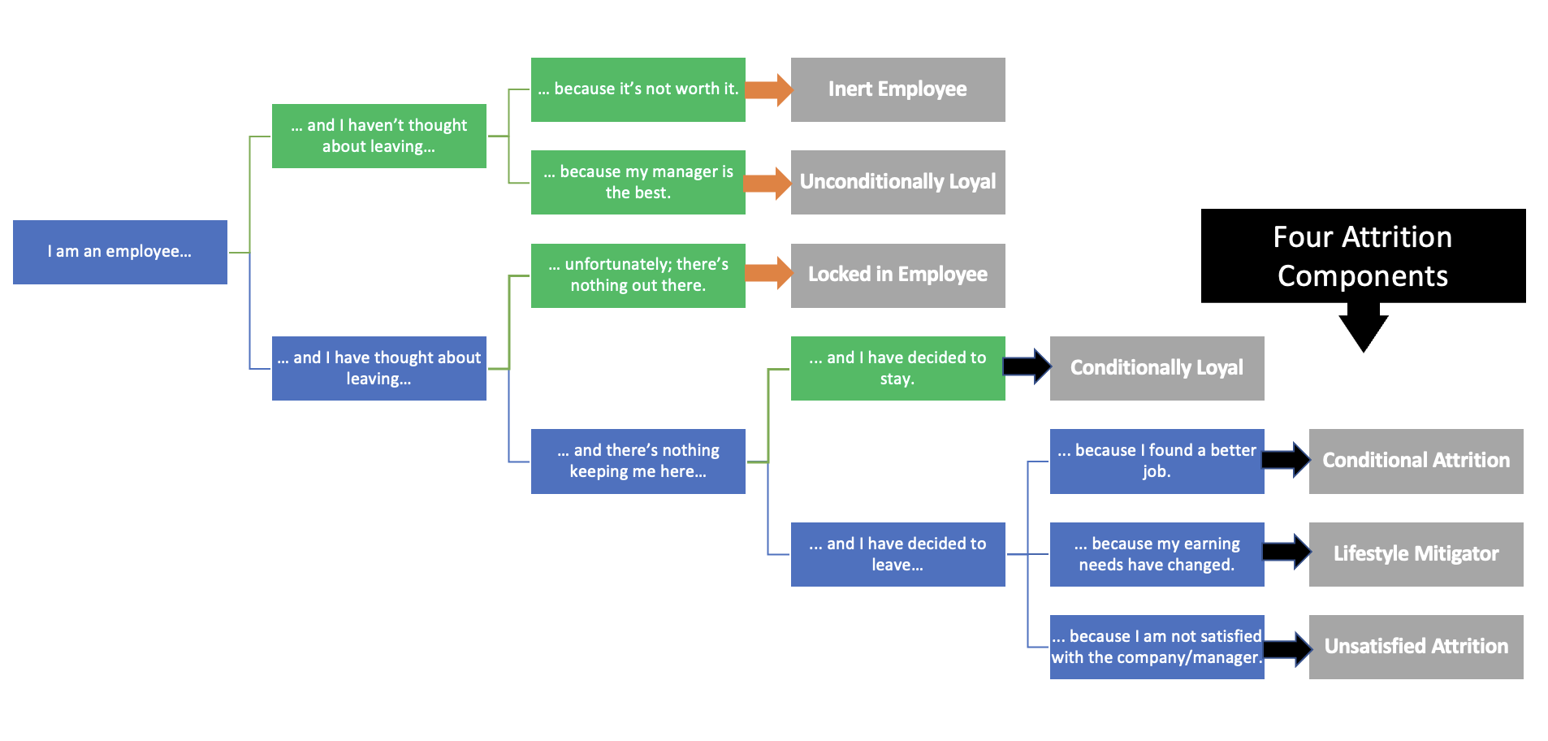
Employee Decision Cycle

Slide 5
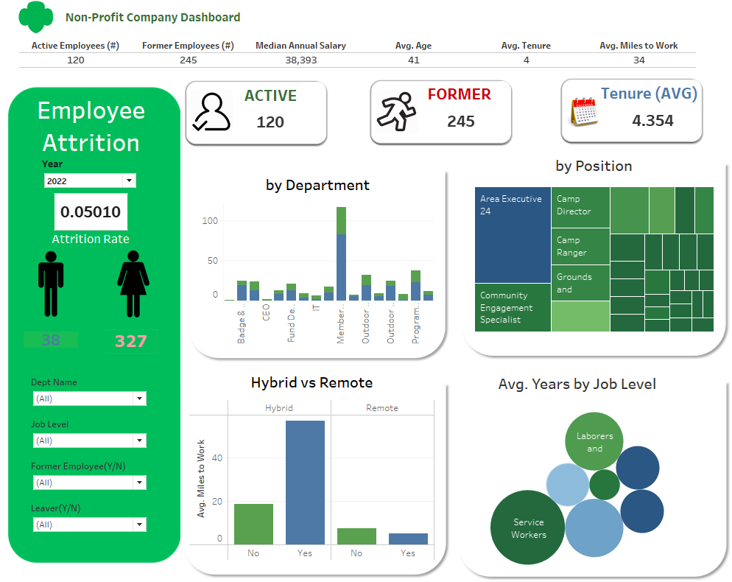
Tableau Dashboard

Slide 6

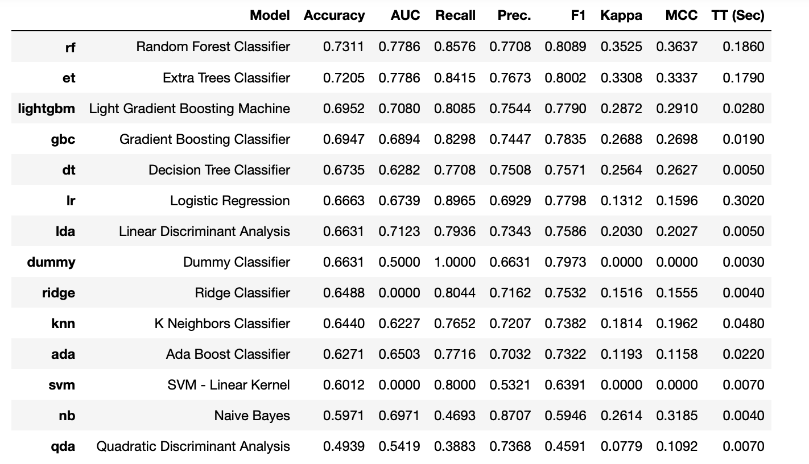
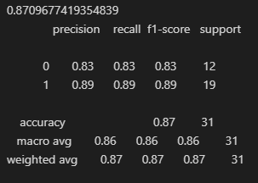
Machine Model and Small Data Set
Model used: Random Forest Classifier
Model Stats
Notes:
Challenges
Small data set; n<500
Incomplete dataset
Constant adjustments to roles and responsibilities
Imbalanced data
Predictive model to better understand who would stay with company based on past data.

Slide 7
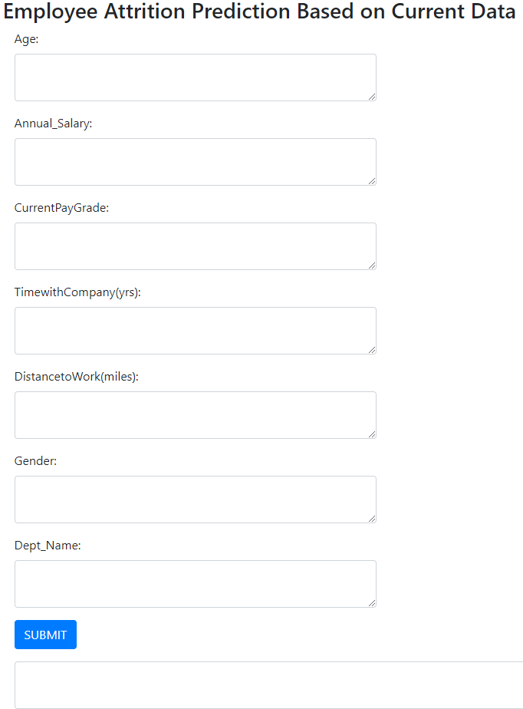
Predictive App

Slide 8

Conclusion: Recommendations to our client
Mandatory collection of reason for leaving code
Minimize number of category and title changes
Create a true succession plan

Slide 9
References
https://learning.linkedin.com/content/dam/me/learning/en-us/pdfs/lil-workbook-calculating-cost-of-employee-attrition-and-disengagement.pdf
https://towardsdatascience.com/breaking-the-curse-of-small-datasets-in-machine-learning-part-1-36f28b0c044d
https://blog.perceptyx.com/employee-attrition-analytics

